Slide 1
MSc Software Development
CSC7061 - Programming
Hello World – Data, Variables, Operators, Intro to Decision making and Compiling

Slide 2

Content
Keywords
Hello Word, datatypes, variables, operators, compiling and execution.
Understanding the structure of a typical Java program
Familiarity with basic data types in Java
Understanding how to declare and use variables in Java
Knowledge of common operators used in Java
Intro to the if statement
Understanding the process of compiling and executing a Java program
Ability to write and run a simple "Hello World" program in Java
What you will learn

Slide 3
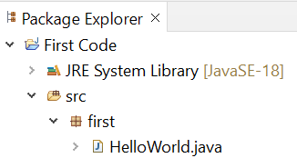
Structure of a Java program
package
Java code is housed in Classes.
Classes are logically grouped together in Packages.
Classes typically contain variables and methods.
class
Package name
Javadoc comment – there are three types of comments in Java. // single line /* */ multiline and /** */ Javadoc
package first;
/**
* Javadoc comment describing the class
* @author Aidan McGowan
*/
public class HelloWorld {
/**
* Start point method for the application
* @param args
*/
public static void main(String[] args) {
// prints screen a message
System.out.println("Hello World QUB");
}
}
A line of Java code finishing with a ; (semi-colon) is known as a statement.
Class name –a class is a type of container into which the Java code is placed. It is also the template or blueprint for an object.
Javadoc comment for the main method
Main method – start point for the application
Single line comment
Executable java statement
Notes:
The Java "Hello, World!" program is a simple program that outputs the message "Hello, World!" to the console. It is often used as a simple introductory example for people learning Java programming for the first time.
The program starts with a class definition named HelloWorld, which contains a single method named main. This method is declared as public, which means it can be accessed from outside the class, and static, which means it can be called without creating an instance of the class.
The main method takes an array of String objects as its parameter, which is used to pass command-line arguments to the program. In this case, we don't use the arguments, so we simply leave the parameter name as args.
The main method contains a single line of code, which uses the System.out.println method to output the message "Hello, World!" to the console.
When the program is run, the main method is executed, which outputs the message "Hello, World QUB" to the console.

Slide 4
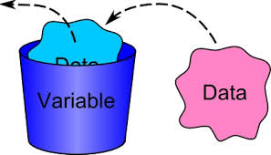
Data
All computer programs ‘deal with’ data. They may read data, process data, output data, etc. This may be simple data such as numbers or characters or more complex data such as student records.
This data needs to be stored somewhere ‘within the computer’ so that it can be accessed whenever necessary. To do this programs make use of variables which are simply named locations or blocks within the computer’s memory.
Java distinguishes between two sorts of data:
Values of primitive data types
Instances of classes (objects)
Variables
A variable is a container that holds values that are used in a Java program.
To be able to use a variable it needs to be declared.
Declaring variables is normally the first thing that happens in any program.
Notes:
Software Development

Slide 5
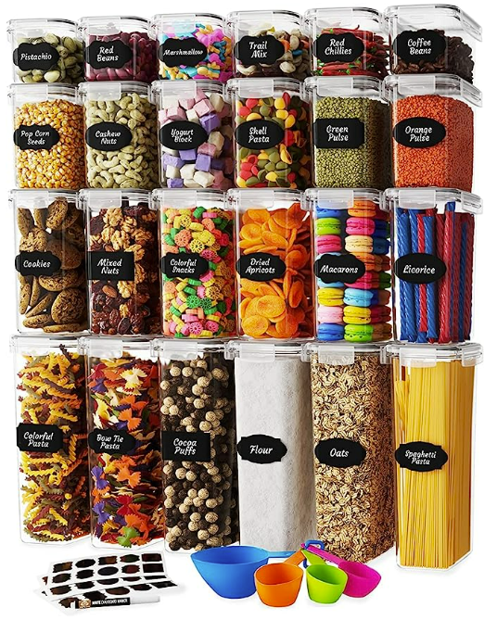
Variables
Think of a bucket.
We can fill it to a certain level, we can replace what's inside it, and sometimes we can add or take something away from it.
When we declare a variable to use a data type it's like putting a label on the bucket that says what it can be filled with.
The bucket can then only hold to its limit and only can hold what it’s been labelled for.
… A good analogy for a variable is to think of a bucket. We can fill it to a certain level, we can replace what's inside it, and sometimes we can add or take something away from it. When we declare a variable to use a data type it's like putting a label on the bucket that says what it can be filled with. Let's say the label for the bucket is "Sand". Once the label is attached, we can only ever add or remove sand from the bucket. Anytime we try and put anything else into it, we will get stopped by the bucket police. In Java, you can think of the compiler as the bucket police. It ensures that programmers declare and use variables properly…
Notes:
A good analogy for a variable is to think of a bucket. We can fill it to a certain level, we can replace what's inside it, and sometimes we can add or take something away from it. When we declare a variable to use a data type it's like putting a label on the bucket that says what it can be filled with. Let's say the label for the bucket is "Sand". Once the label is attached, we can only ever add or remove sand from the bucket. Anytime we try and put anything else into it, we will get stopped by the bucket police. In Java, you can think of the compiler as the bucket police. It ensures that programmers declare and use variables properly.

Slide 6

Choosing Variable Names
The name given to a variable is known as an identifier. There are certain rules for identifiers: No Reserved words.
Cannot start with a digit but digits can be used after the first character (e.g., name1, n2ame are valid).
Start with a letter, an underscore (i.e., "_") or a dollar sign (i.e., "$").
Cannot use other symbols or spaces (e.g., "%","^","&","#"). Should start with lowercase names.
Always give your variables meaningful identifiers. If a variable holds the price of a book, then call it something like "bookPrice". If each variable has a name that makes it clear what it's being used for, it will make finding errors in your programs a lot easier.
Camel case
The practice of writing compound words or phrases such that each next word or abbreviation begins with a capital letter. Camel case may start with a capital or, especially in programming languages, or with a lowercase letter. E.g. bookPrice.

Slide 7
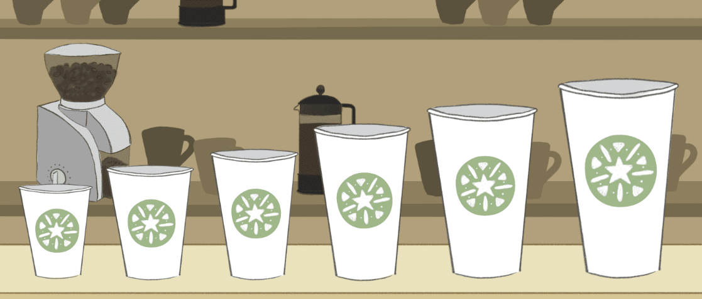
Primitive data types
Java has 8 primitive data types
Java is a strongly typed programming language. This means that every variable must have a data type associated with it. In Java, primitive data types are the most basic data types available in the language. They are built-in data types and are not objects like the classes and interfaces in Java. These primitive data types are used to define variables, parameters, and return types of methods. They are also used in arithmetic operations, logical operations, and bitwise operations.
byte - integer value
short - integer value
int - integer value
long – integer value
float – floating point number
double – floating point number
boolean - either true or false
char - a single character
Notes:
In Java, primitive data types are the most basic data types available in the language. They are built-in data types and are not objects like the classes and interfaces in Java. Here are the eight primitive data types in Java:
boolean: This data type has only two possible values, either true or false. It is used to represent logical values.
byte: This data type is used to represent integer values from -128 to 127. It takes 8 bits of memory.
short: This data type is used to represent integer values from -32,768 to 32,767. It takes 16 bits of memory.
int: This data type is used to represent integer values from -2,147,483,648 to 2,147,483,647. It takes 32 bits of memory.
long: This data type is used to represent integer values from -9,223,372,036,854,775,808 to 9,223,372,036,854,775,807. It takes 64 bits of memory.
float: This data type is used to represent floating-point numbers with single precision. It takes 32 bits of memory.
double: This data type is used to represent floating-point numbers with double precision. It takes 64 bits of memory.
char: This data type is used to represent a single character. It takes 16 bits of memory.
These primitive data types are used to define variables, parameters, and return types of methods. They are also used in arithmetic operations, logical operations, and bitwise operations.

Slide 8
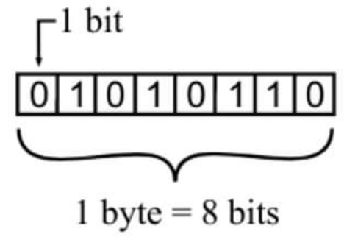
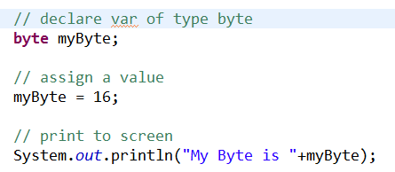
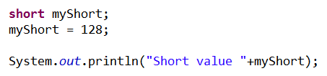
Primitive data types
byte
Byte data type is an 8-bit signed two's complement integer.
The minimum value is -128 (-2^7)
Maximum value is 127 (inclusive)(2^7 -1)
Default value is 0
Byte data type is used to save space in large arrays mainly in place of integers, since a byte is four times smaller than an int.
short
Short data type is a 16-bit signed two's complement integer.
Minimum value is -32,768 (-2^15)
Maximum value is 32,767 (inclusive) (2^15 -1)
Short data type can also be used to save memory as byte data type. A short is 2 times smaller than an int
Default value is 0.

Slide 9
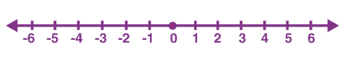
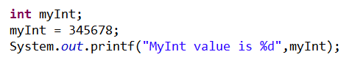
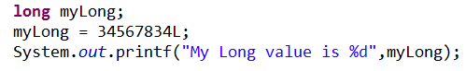
Primitive data types
int
int data type is a 32-bit signed two's complement integer
Minimum value is - 2,147,483,648.(-2^31)
Maximum value is 2,147,483,647(inclusive).(2^31 -1)
int is generally used as the default data type for integral values unless there is a concern about memory.
The default value is 0.
long
Long data type is a 64-bit signed two's complement integer. Minimum value is -9,223,372,036,854,775,808.(-2^63)Maximum value is 9,223,372,036,854,775,807 (inclusive). (2^63 -1)
This type is used when a wider range than int is needed.
Default value is 0.

Slide 10
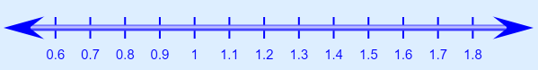
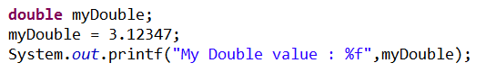
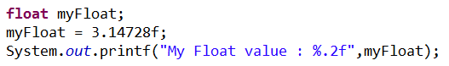
Primitive data types
double
double data type is a double-precision 64-bit IEEE 754 floating point.
This data type is generally used as the default data type for floating point number values.
Default value is 0.0
float
Float data type is a single-precision 32-bit IEEE 754 floating point.
Float is mainly used to save memory in large arrays of floating point numbers.
Default value is 0.0f.

Slide 11

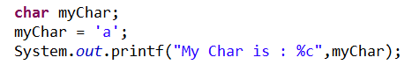
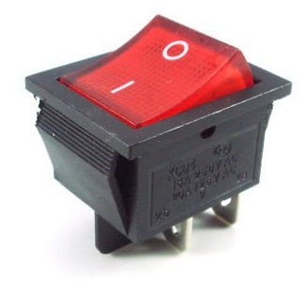
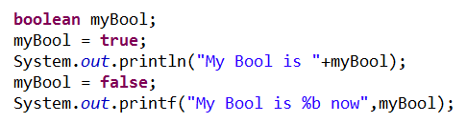
Primitive data types
char
char data type is a single 16-bit Unicode character.
Minimum value is '\u0000' (or 0).
Maximum value is '\uffff' (or 65,535 inclusive).
Char data type is used to store any character.
boolean
boolean data type represents one bit of information.
There are only two possible values: true and false.
This data type is used for simple flags that track true/false conditions.
Default value is false.

Slide 12
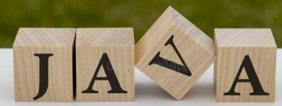
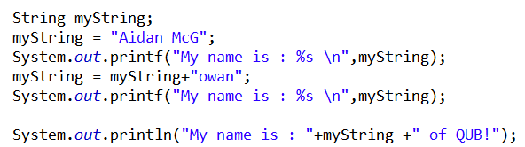
Reference Data Types
Reference variables are created using defined constructors of the classes. They are used to access objects. These variables are declared to be of a specific type that cannot be changed. For example, Employee, Dog, etc.
Class objects and various types of array variables come under reference data type.
The default value of any reference variable is null.
A reference variable can be used to refer to any object of the declared type or any compatible type.
Example: Animal animal = new Animal("giraffe");
String
An example of a reference data type is Java’s String. A string is a sequence of characters. It is represented by the java.lang.String class and is one of the most commonly used data types in Java programming.
A string in Java is declared by enclosing a sequence of characters in double quotes (").
Concatenation of two strings
Notes:
A string in Java is declared by enclosing a sequence of characters in double quotes ("). For example:
String greeting = “Hello, World!”;
In this example, the greeting is a variable of type String that contains the text "Hello, World!".
Strings in Java are immutable, which means that once a string object is created, its value cannot be changed. However, operations on strings can create new string objects with modified values. For example:
String greeting = "Hello, ";
String name = "Alice";
String message = greeting + name;
// message is "Hello, Alice"
In this example, the + operator concatenates the greeting and name strings to create a new string object with the value "Hello, Alice".
The java.lang.String class provides many methods for manipulating strings, such as length(), charAt(), substring(), indexOf(), toLowerCase(), toUpperCase(), and many more.
These methods allow you to perform tasks such as extracting substrings, converting the case of the characters, and searching for specific characters or substrings within a string.

Slide 13

Data storage exercise – Say my name!
Write a program that will store your name and your age.
Output the details to the screen.
Things you’ll need to consider.
You’ll need two variables, one for name and one for age. Consider the appropriate data types.
Carefully consider the name for each variable and the naming conventions (lower case and then upper (no spaces between) for compounded words).
Expected output
My name is Aidan. My age is 21
Notes:
Solution :
// declare the vars
int myAge;
String myName;
// initialise the var - assign a value
myAge = 21;
myName = "Aidan";
// output to screen
System.out.println("My name is "+myName +". My age is " +myAge);

Slide 14
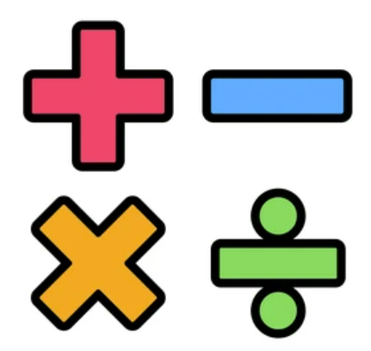
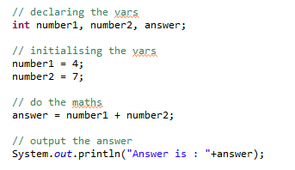
Operators
Now that we can store data, we’ll want to be able to do something with it. Java operators are symbols that are used to perform various operations on values or variables. There are several types of operators in Java: including Comparison Operators, Logical Operators, Assignment Operators, Conditional Operators and :
Arithmetic Operators: These are used to perform basic mathematical operations such as addition, subtraction, multiplication, division, and modulus. The arithmetic operators are represented by symbols such as +, -, *, /, and %.

Slide 15
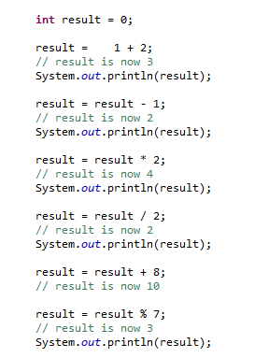
Arithmetic Maths operators in action
The = is known as the assignment operator. It assigns a value to the variable
Everything to the right of the = operator is evaluated before the assignment.
Portions of statements that contain calculations are called expressions.
An expression in Java is a combination of one or more variables, values, operators, and method calls that can be evaluated to produce a result. It can represent a computation or a value that needs to be computed or retrieved.
Notes:
An expression in Java is a combination of one or more variables, values, operators, and method calls that can be evaluated to produce a result. It can represent a computation or a value that needs to be computed or retrieved.
For example, the following are examples of Java expressions:
2 + 3: This expression represents the addition of two integers, which evaluates to 5.
5 * 6: This expression represents the multiplication of two integers, which evaluates to 30.
myVariable + 10: This expression represents the addition of the value stored in a variable named 'myVariable' with the integer value 10.
Math.max(7, 9): This expression represents a method call to the 'max' method of the Math class, which returns the maximum value between two integer arguments, in this case 7 and 9.
(5 > 3) && (4 < 6): This expression represents a logical AND operation between two boolean expressions, which evaluates to true.
Expressions can be used in various contexts in Java, such as in assignments, method calls, conditional statements, loops, and more. They are an essential part of programming in Java and are used extensively in writing efficient and effective code.

Slide 16
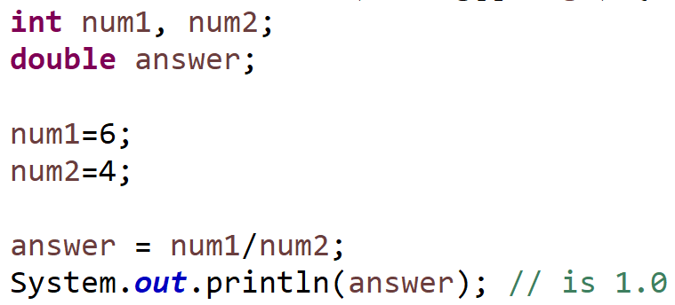
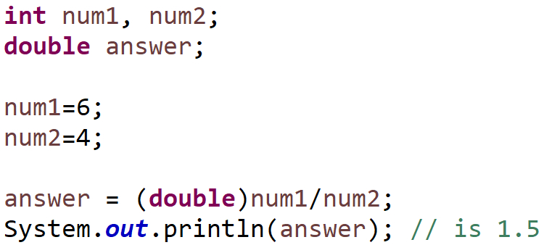
Casting
Casting is a way to explicitly convert or change the data type of a variable from one type to another. Casting is primarily used when you want to assign a value of one data type to a variable of another data type, and the conversion between these types might result in a loss of precision or potential data loss
When you perform the division operation 6/4, the result might not be what you expect because both the numerator (6) and denominator (4) are integers. In integer division, the result will be truncated to an integer, and any fractional part will be discarded
(double) is a casting operation. It explicitly converts the value of num1 from its original data type (which is int) to a double (within the expression). This casting is performed to ensure that the division operation is a floating-point division, which allows for any decimal values to be retained in the result.
Notes:
(double) is a casting operation. It explicitly converts the value of num1 from its original data type (which is int) to a double. This casting is performed to ensure that the division operation is a floating-point division, which allows for decimal values to be retained in the result.
num1 is cast to a double before the division is performed. This is important because if you divide two int values, you get integer division, which truncates the decimal part. By casting num1 to a double, you ensure that the division is done as a floating-point division, preserving the decimal part of the result.
The division num1 / num2 is then performed with the double version of num1. The result of this division is a double value.
Finally, the result of the division (a double) is assigned to the answer variable, which is also declared as a double. This assignment stores the result of the division as a floating-point number in the answer variable.
So, casting is used in this example to explicitly convert num1 from an int to a double to ensure that the division is performed as a floating-point division, and the result is stored as a double in the answer variable.
Note : Casting can only be used to convert compatible data types e.g. int to double, but not String to int. There are other processes for these kinds of conversions (more of this later !)

Slide 17
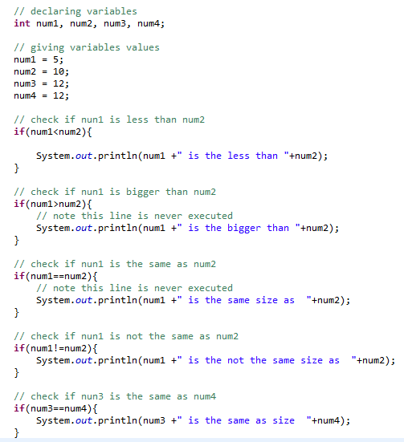

Decision making
A condition is an expression that can be true or false.
Java’s if selection statement allows a program to make a decision based on a condition’s value.
If the condition in the if statement is true the body of the if statement executes otherwise it is ignored.
Conditions in the if statement are performed by the equality operators and the relational operators
equality
== Equal to
!= Not equal to
relational
> Greater than
>= Greater than or equal to
< Less than
<= Less than or equal to

Slide 18
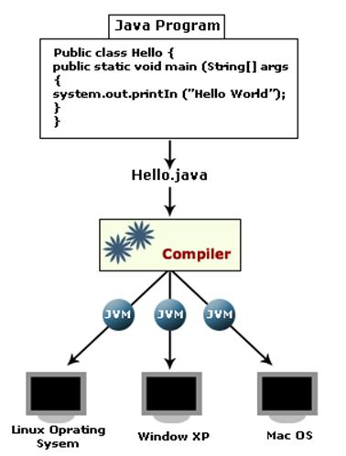
Compiling and running
Developers write the source code which is saved with the file extension .java.
Javac is then used to turn (i.e. compile) this source code into bytecode.
After Javac has finished compiling the bytecode, it creates a new file with the extension .class.
Once the class file has been created, it can be run on the Java Virtual Machine (JVM). It is a crucial component of the Java Runtime Environment (JRE). The JVM is responsible for executing Java bytecode, which is a compiled form of Java source code. It provides an abstraction layer between the Java code and the underlying hardware, allowing Java programs to be platform-independent and portable across different operating systems.
Notes:
JRE stands for Java Runtime Environment, and it is the software environment required for running Java applications. The JRE includes the Java Virtual Machine (JVM), the Java class libraries, and other components required for executing Java applications.
When a Java application is run, the JRE is responsible for loading the necessary class files, linking them with the JVM, and providing the necessary runtime environment for executing the application. The JRE includes several components, including:
Java Virtual Machine (JVM): The JVM interprets the Java bytecode and converts it into machine code that can be executed by the underlying hardware.
Java Class Libraries: The Java class libraries are a collection of pre-written Java code that provides a wide range of functionality, including file I/O, networking, database access, and more.
Java Plug-in: The Java plug-in is a browser plug-in that enables Java applets to run in web browsers.
Java Web Start: Java Web Start is a framework for deploying Java applications on the web.
JavaFX: JavaFX is a platform for building rich internet applications (RIAs) using Java.
The JRE is available for download from the official Java website and is available for multiple platforms, including Windows, Linux, and macOS. It is essential to have the correct version of the JRE installed on the computer to ensure that Java applications run correctly.
Overall, the JRE is a crucial component of the Java ecosystem, and its ability to provide a consistent runtime environment across multiple platforms has made Java one of the most popular programming languages in use today.

Slide 19

Summary
This lecture covered the basics of writing a Java program, starting with the "Hello World" program. The structure of a typical Java program was explained, including data types, variables, and operators. The process of compiling the program is also outlined.
Get coding! Try out the self-test quiz and the lab exercises.
Things to do next :

